Slide 1

BRAND IDENTITY GUIDELINE
www.internationalbankingacademy.com

Slide 2

Welcome
These brand guidelines are intended to guarantee a consistent look & tone in all communications. The sections that follow will help you understand our brand, what it stands for, and how to best convey it.
03
www.internationalbankingacademy.com

Slide 3
About Us
This document communicates the visual Identity of International Banking Academy.
This Academy is dedicated to Unleashing Excellence at the International Banking Academy.
03
www.internationalbankingacademy.com

Slide 4

COMPLETE LOGO DESIGN.
Name , company logo, colours, typeface: these are the pillars of the identity of the company. Their characteristics ensure an individual and consistent image of the company on the market. The graphic of the defi nitive logo is very clean, square, linear, essential, strong and emphasizes
the values of the brand. The logo is a graphic comprised of the wordmark (logotype) and figurative mark (symbol). The lettering is created using the Avenir typeface, and the stylized fox is inseperable. The logo should be always produced from the master artwork. The only time you should use the symbol alone is on the website or social media channels where there are other elements to help the user recognise the brand.
04
www.internationalbankingacademy.com

Slide 5


LOGO COSTRUCTION
Designing a logo and a visual identity goes way beyond the free form and artistic side of what most people think. There is all the rational part including proportions, scaleability optical adjustments and reproduction that has to be thought in order to create an effi cient & well design logo. The visual design guidelines will provide this information to ensure that the brand is used correctly. Here we
want to illustrate the construction or guidelines of our logo.
05
www.internationalbankingacademy.com

Slide 6




















INVERTED COLOURS
The International Banking Academy logo can exist with an “inverted” colour scheme, which means that the main colour is gradient blue & the logo remains gradient blue on a midnightblue background.
06
www.internationalbankingacademy.com

Slide 7











BLACK & WHITE
The monocromatic version has been specifi cally designed to meet some specifi c printing requirements They
should not be used in other circumstances.
07
www.internationalbankingacademy.com

Slide 8
COLOR PALETTE
Our company colours are professional and modern, expressing who we are Pantone blue purple is the main colour of the international banking academy identity so it has the strongest presence on our brand. Pantone bright turquoise complements the turquoise colour, creating balance and making the
palette more distinctive & sophisticated. Pantone midnight blue balances the other colours and gives space to the elements. Alternative colours should not be introduced into the system, or they would reduce the impact of our colour palette.
08
www.internationalbankingacademy.com

Slide 9
OPEN SANS FONT FAMILY
Aa
light regular semibold bold extrabold
TYPOGRAPHY
Typography is a powerful tool in the development of a creative identity and is a key element to create a cohesive look across all communications. Using a typeface consistently makes it recognisable; it pulls together communications and makes them more distinctive. The style of type
we use to bring our communication to life sets the tone of our brand: clean, modern, stylish, distinctive and legible. The selected font is an all time classic: Open Sans
ABCDEFGHIJKLMNOPQRSTUVWXYZ
abcdefghijklmnopqrsutvwxyz
0123456789 !”$%&/()=?
The quick brown fox jumps over the lazy dog
The quick brown fox jumps over the lazy dog
The quick brown fox jumps over the lazy dog
09
www.internationalbankingacademy.com

Slide 10


Slide 11
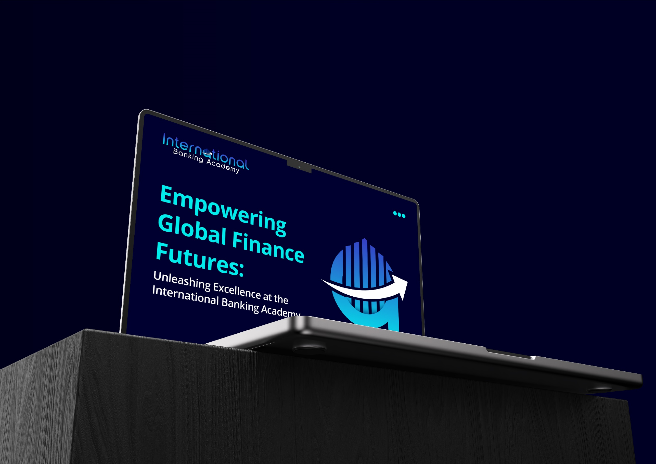

Slide 12
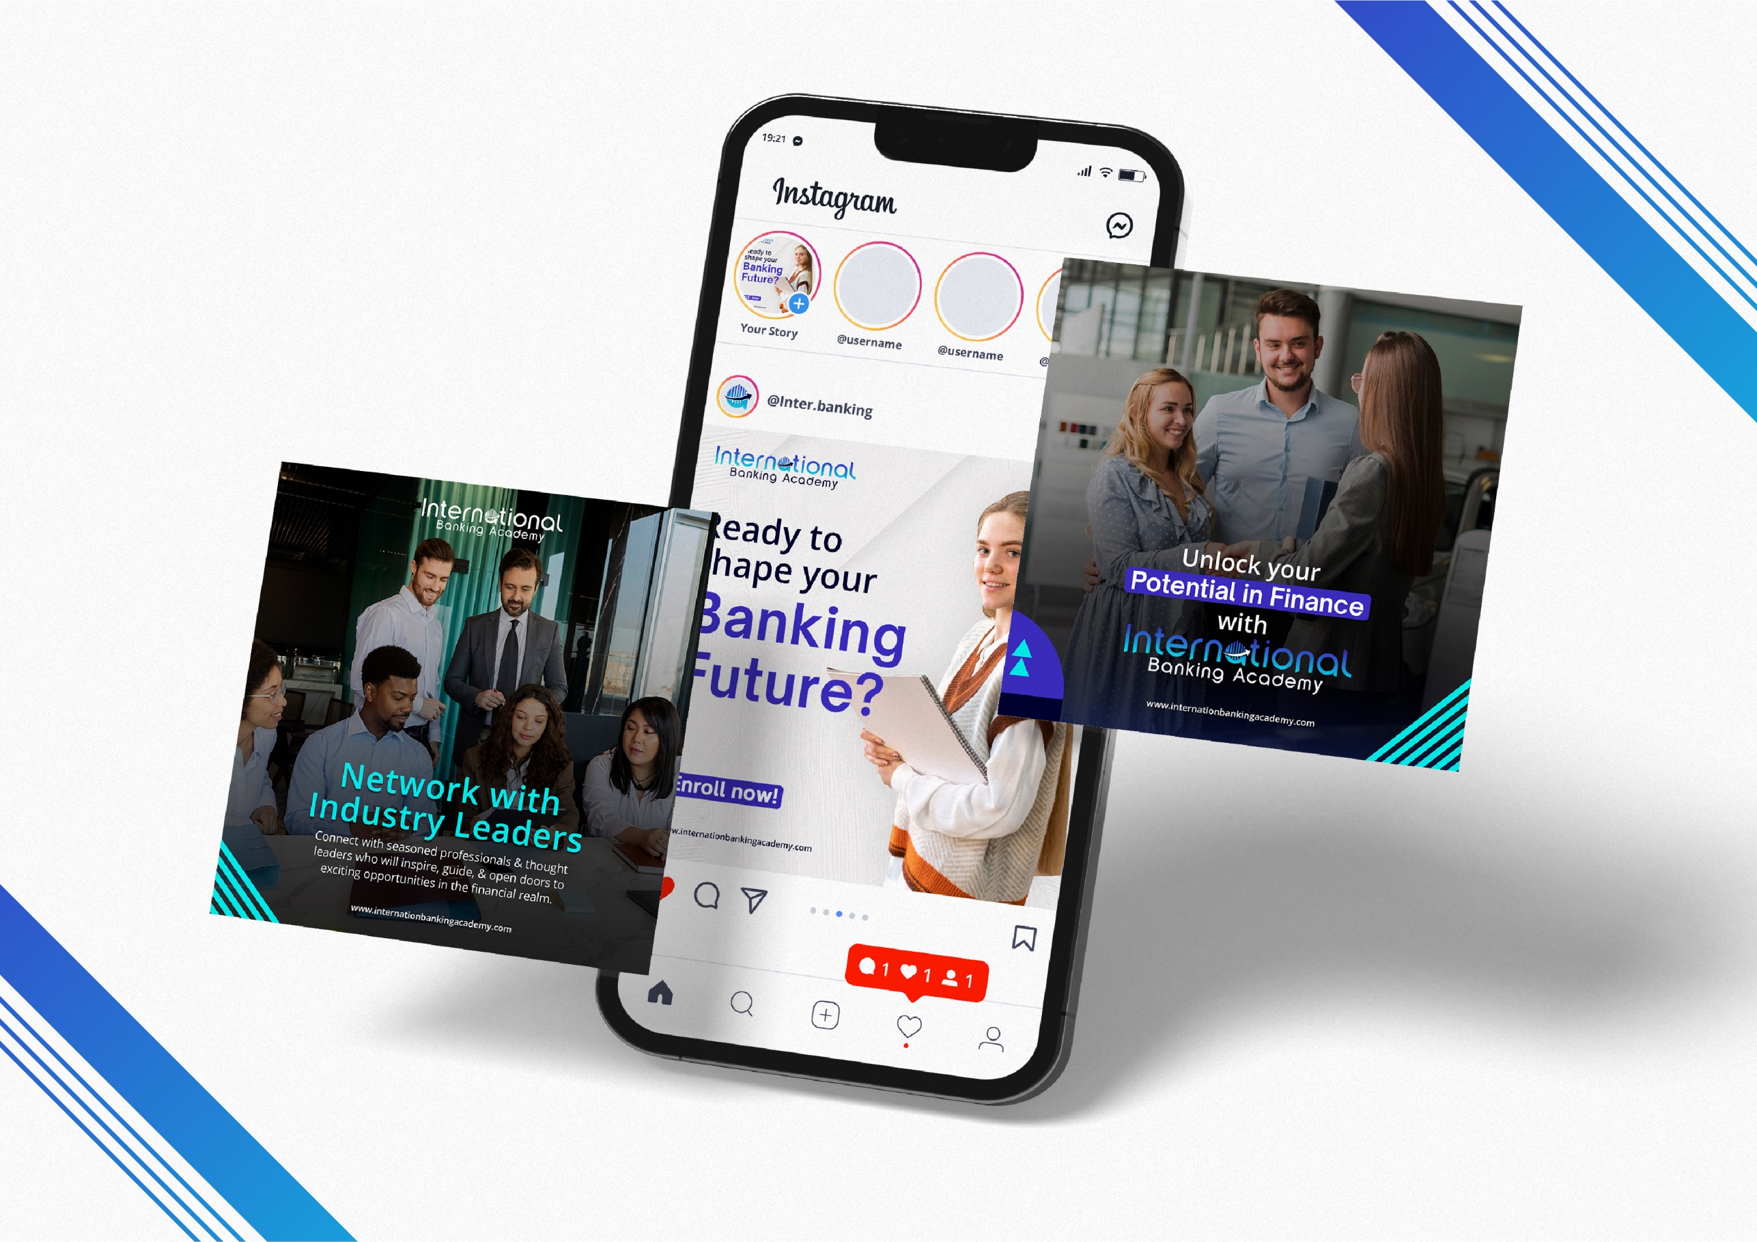



Slide 13
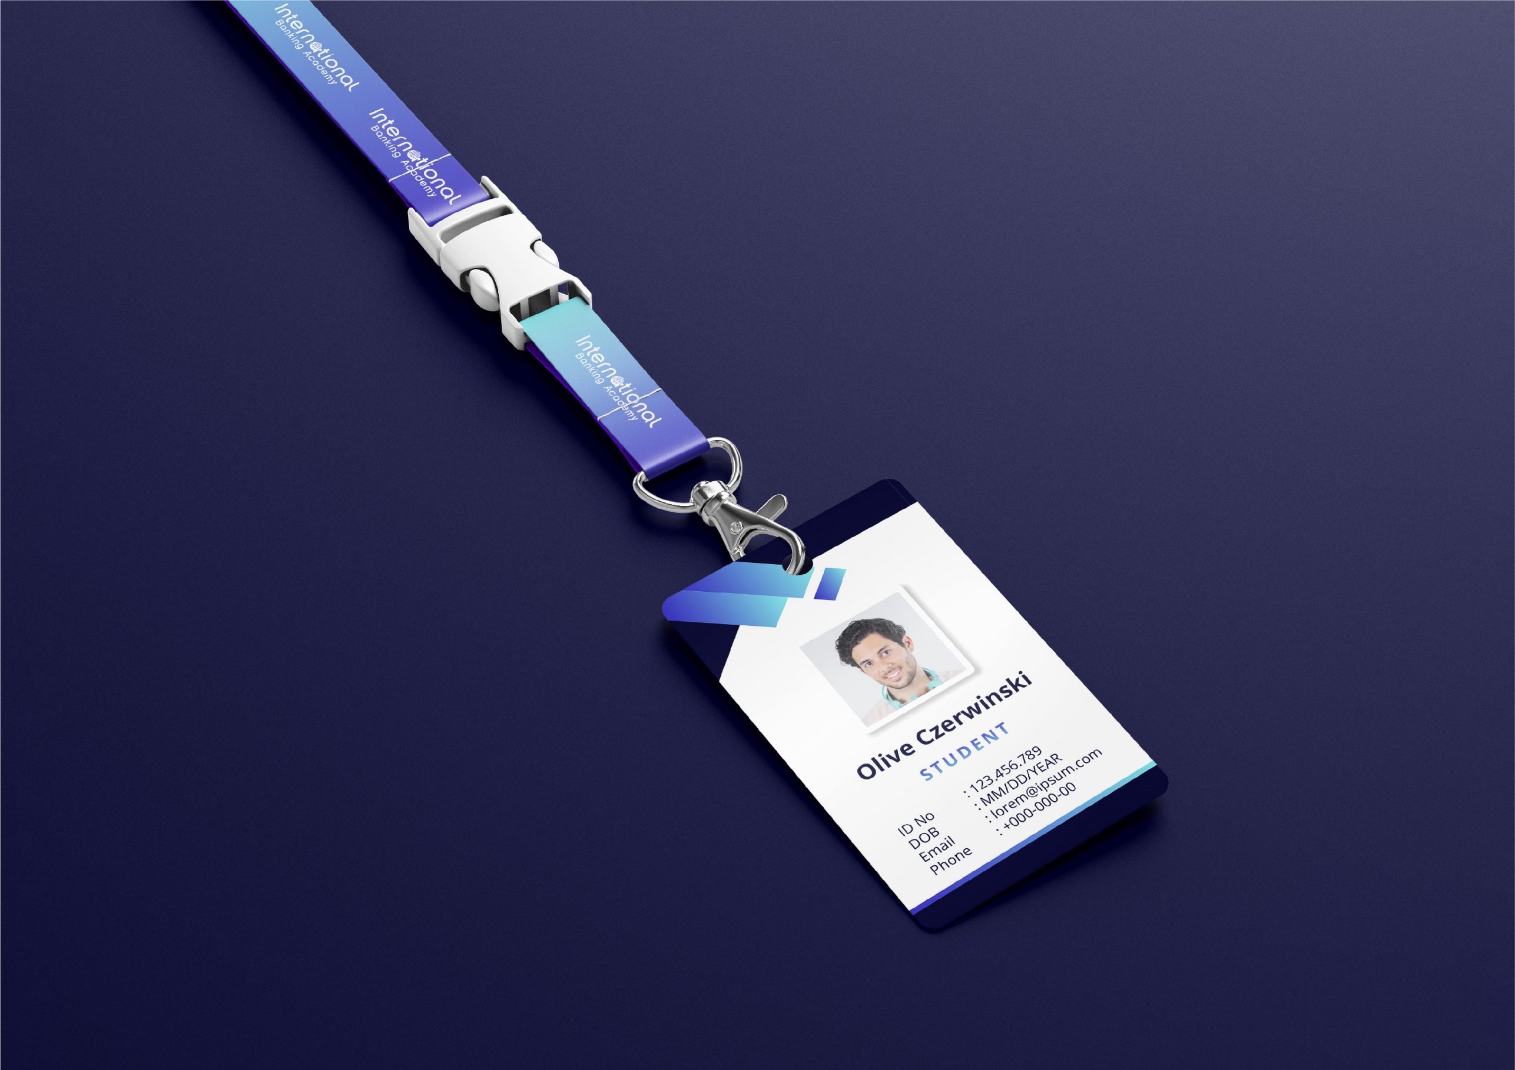








Slide 14
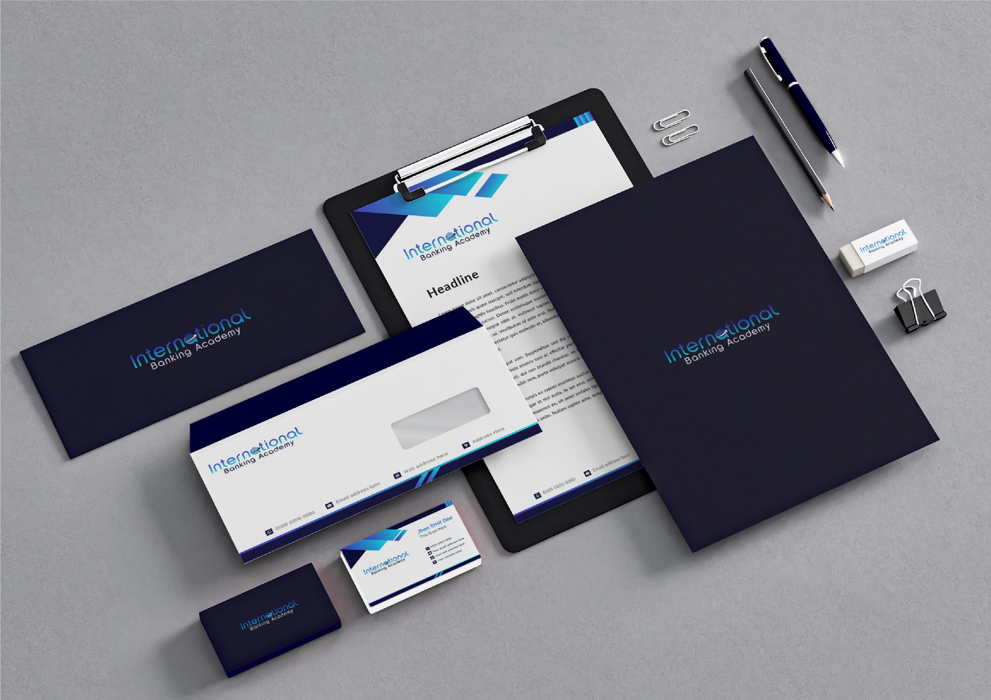

Slide 15


Slide 16
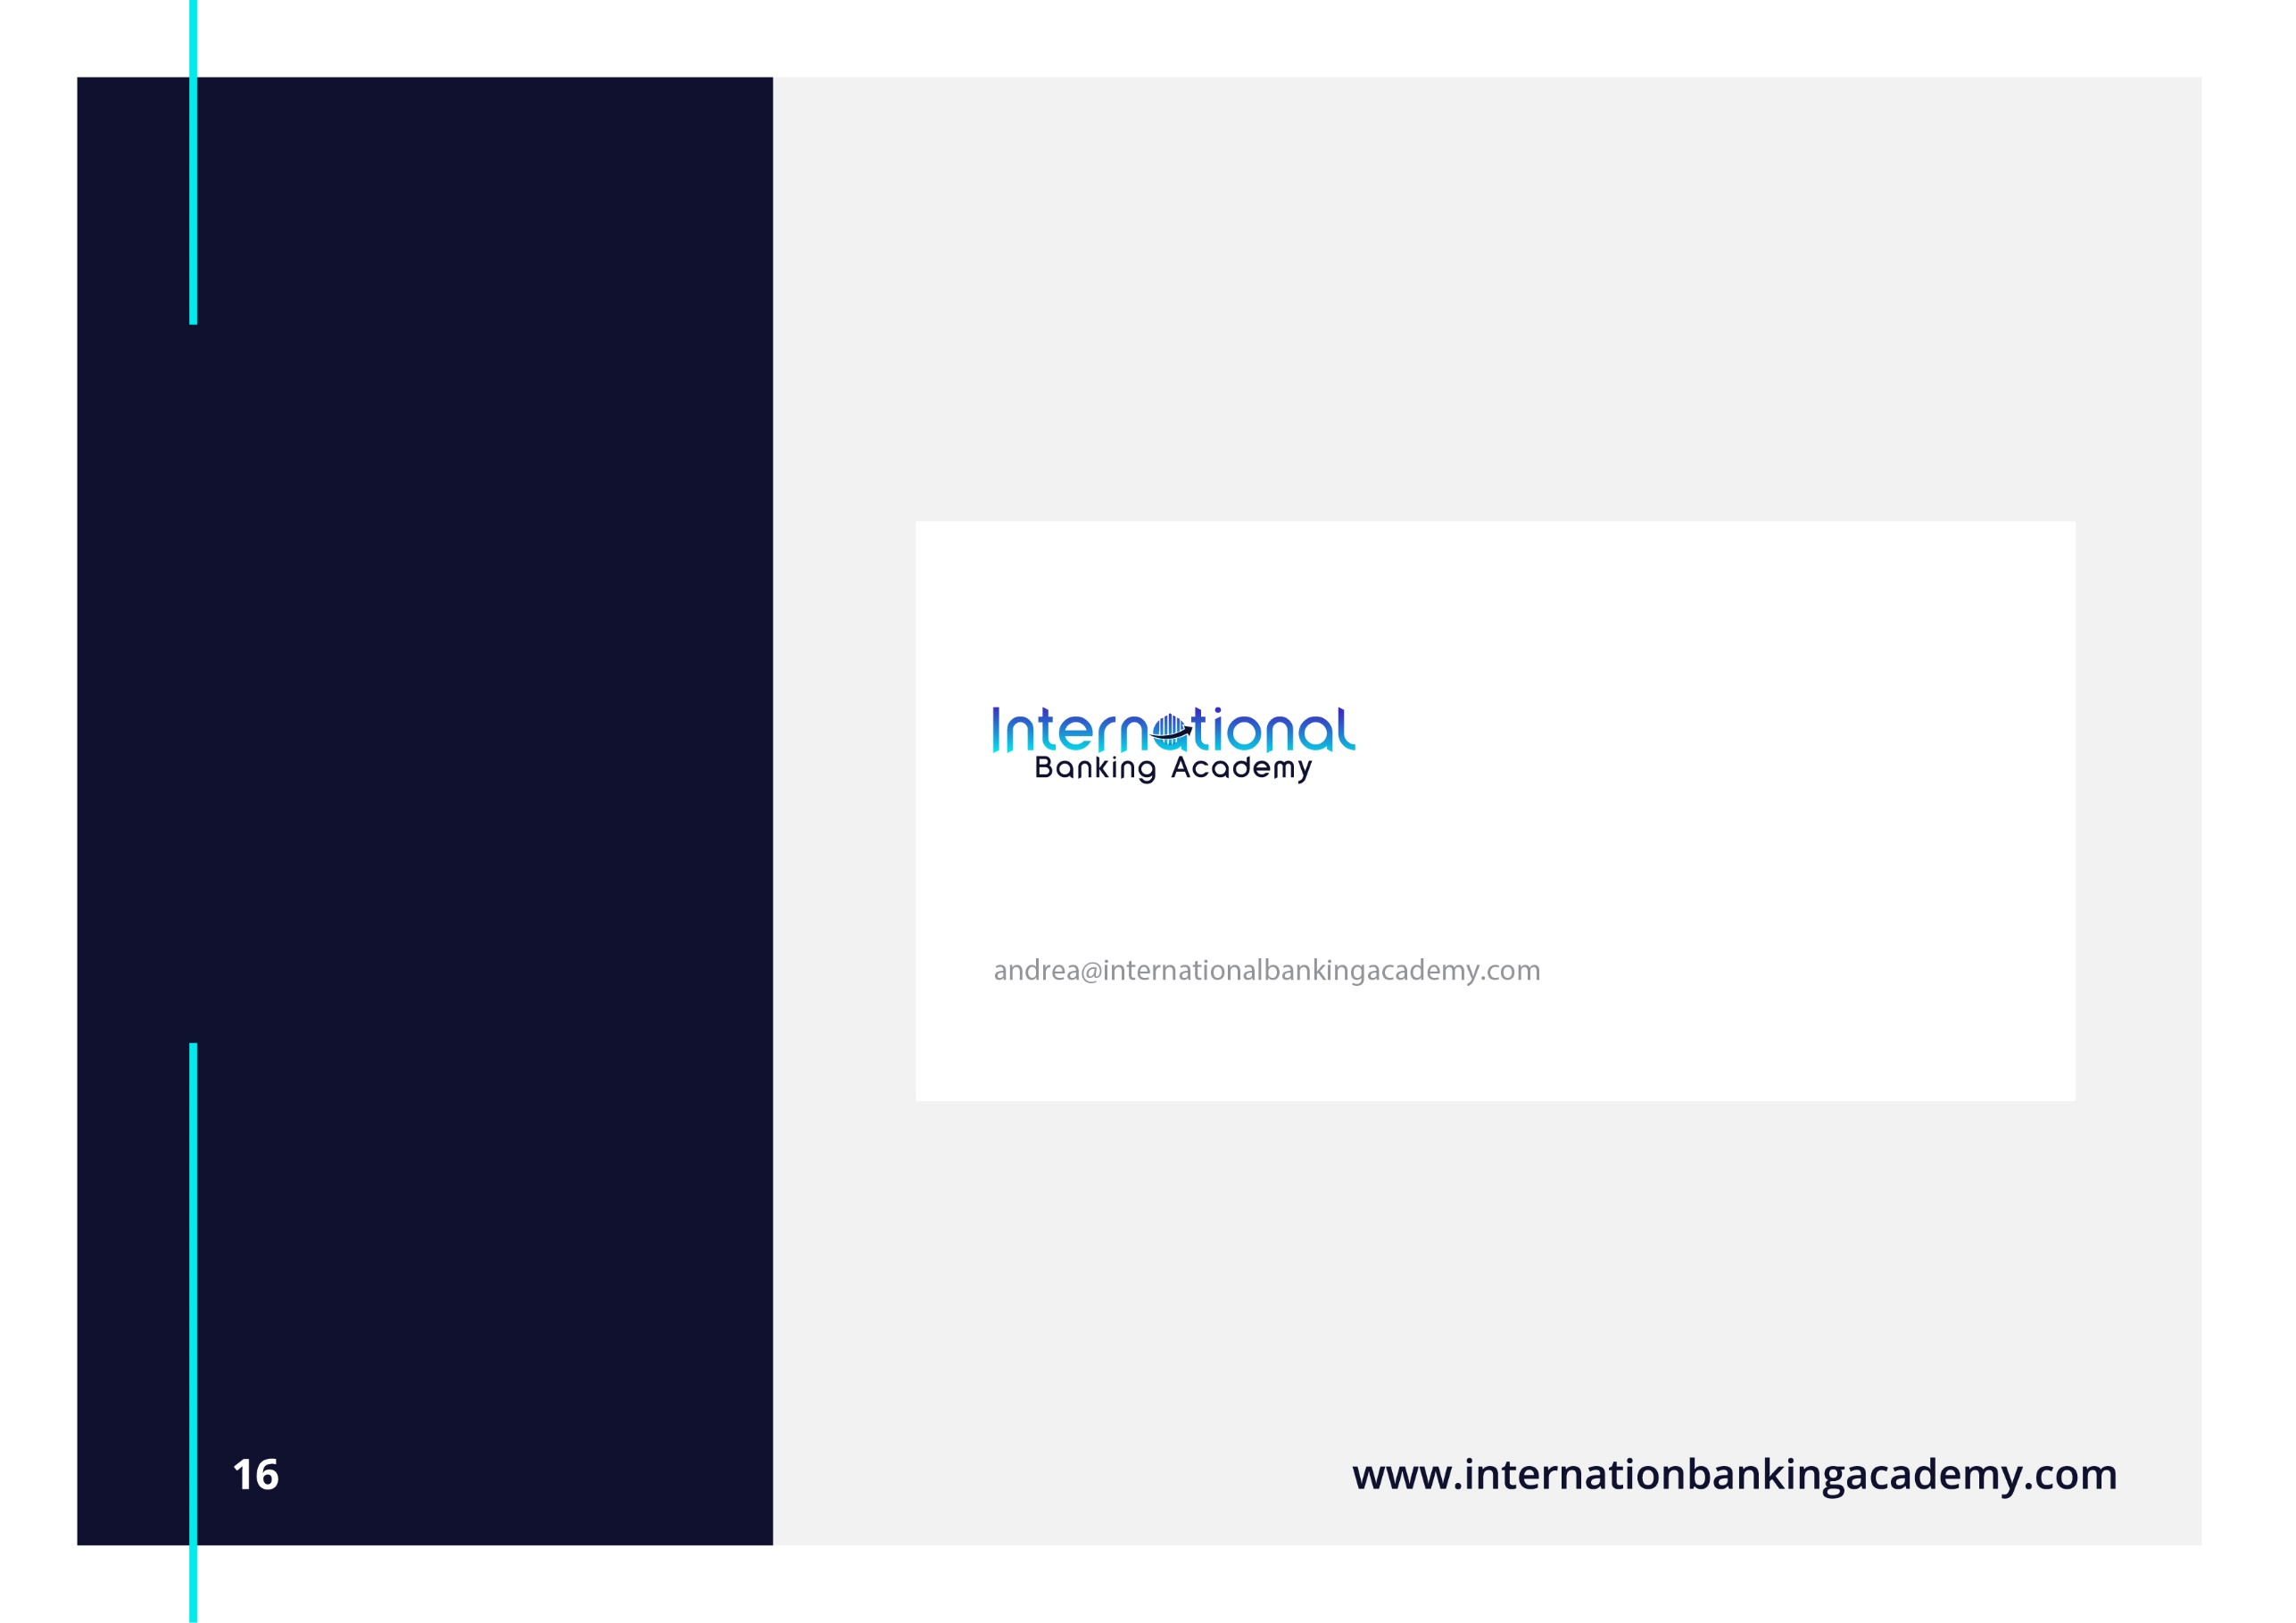
EMAIL SIGNATURE
For a strong corporate image , all
e-mail messages should identify the sender in a standard & clear manner. Please follow the example shown. It is possible to create a default e-mail signature through your e-mail program. As in the example, you can set up the program to automatically add your signature to the end of every e-mail you send. E-mail signatures should be light grey text with bright turquoise & midnight blue accents. To keep a professional look and to minimize
file size, do not add any additional graphics, logos, slogans, or messages to your e-mail signature.
ANDREA BALZANO | Ceo
International Banking Academy
Office +123 456 7890 | Fax +123 456 7890 | Cell +123 456 7890
andrea@internationalbankingacademy.com www.internationalbankingacademy.com

Slide 17




















CONTACTS
Main Street 28,
Milan 12345, USA
+(123) 456 7890
info@internationalbankingacademy.com www.internationalbankingacademy.com
Thank You.

